Slide 1
Nexus Contact Manager
A Comprehensive Overview of Our Modern Web Application Design
Company name

Slide 2

Nexus Contact Manager
This program is a personal contact manager.
A user will be able to create an account. An account will allow a user to add their own contacts.
With contacts added, a user will be able to search for, edit, and delete their contacts.

Slide 3
01
Group Overview

Slide 4




Team Members
Youri Antoine – API/Database
Shane Solomon-Hollett – API
Sammy Fares – Front End
Nolphky Nicolas – Front End
Sean Kenney – Project Manager

Slide 5
02
Technical Aspects

Slide 6










Tech Frameworks
Github – Utilized for Source Control
DigitalOcean – Droplet hosting
GoDaddy – Domain Provider
Postman and Swaggerhub – API documentation and testing
Other Resources – Coding support
Canva and GanttPro – Charts and Diagrams
Communication & Collab

Slide 7
Challenges Faced
Working through the project with vastly different schedules proved challenging with:
Scheduling meetings earlier in the process.
Delayed communication.
Handling unexpected deployment issues
Git , Apache, Domain setup
Those challenges did provide opportunities to work well together:
Strong collaboration between roles in frontend/backend.
Finding and applying solutions together.
Writng out Documentation , (KB) for everyone to stay aligned
Hand on problem solving during live server errors
Quality Assurance Meetings

Slide 8
03
Project Management

Slide 9
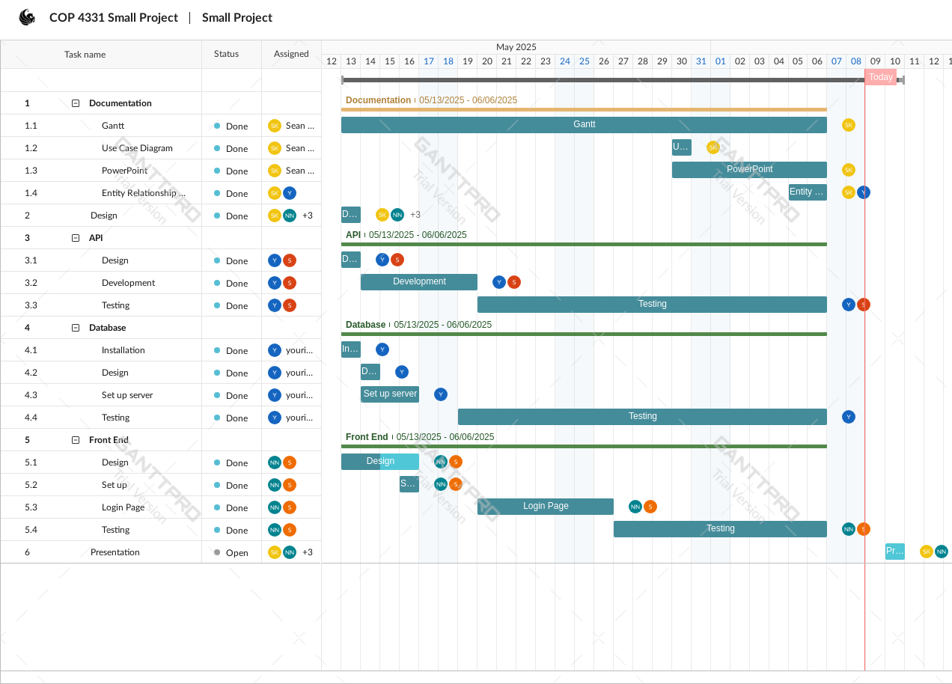
Gantt Chart
This slide will present Gantt charts that delineate the project timeline, displaying key milestones, deliverables, and deadlines throughout the Nexus Contact Manager development cycle. The visual representation will aid in understanding project flow and resource allocation.

Slide 10
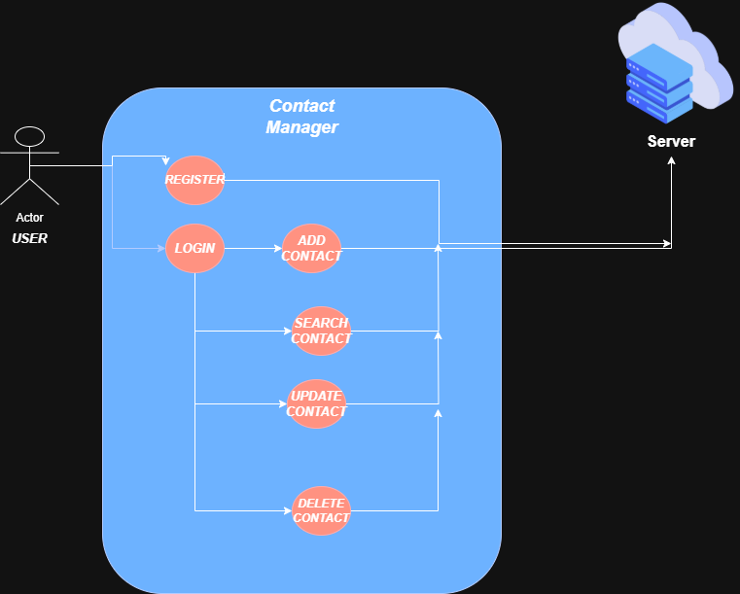
Use Case Diagrams

Slide 11
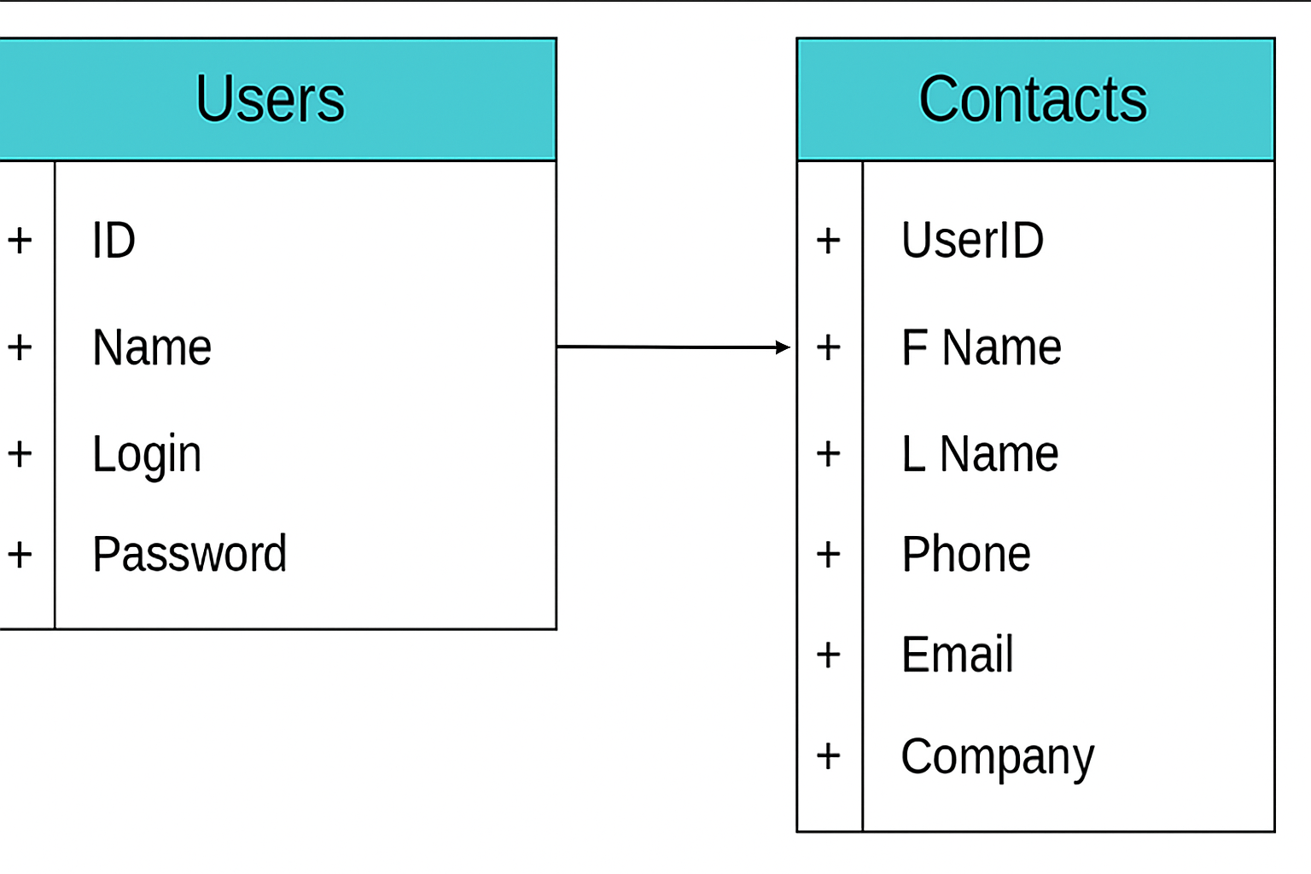
Entity Relationship Diagram
Relationship:
One to Many Relationship
A single User (ID) can have Multiple Conacts
UserID in the Contacts table acts as a foreign key referencing ID of the Users Table
Purpose:
This structure ensures that every contact is associated with one user, this is ideal for personal contact managers or CRM Style applications

Slide 12
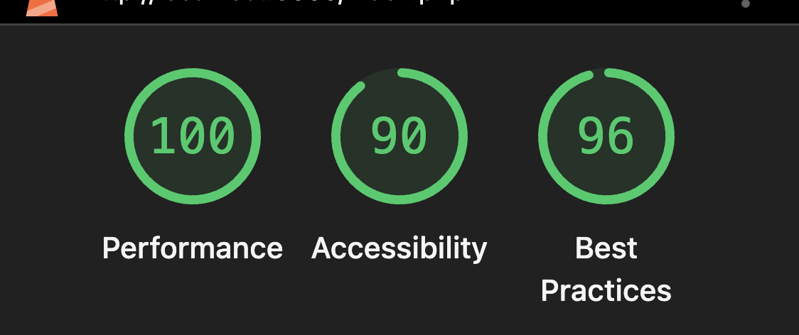
Lighthouse Reports

Slide 13
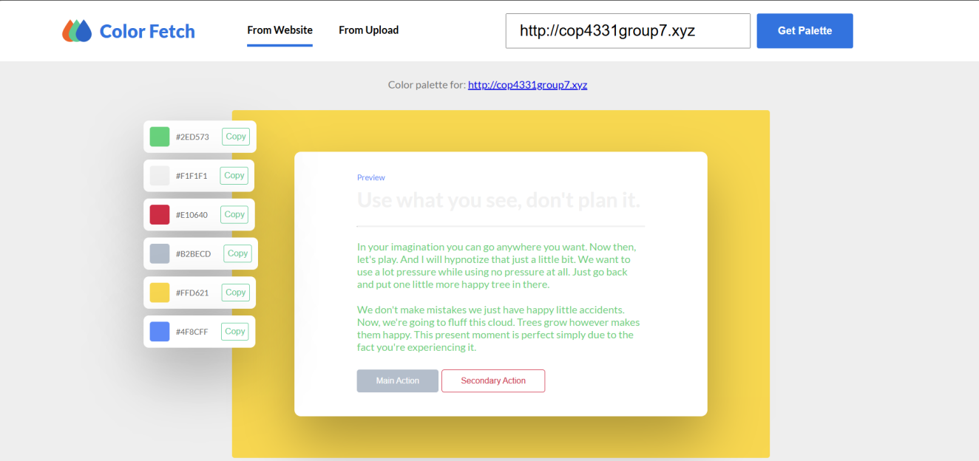

Color Pallete Demo
Selected and validated our color palette not just for aesthetics, but for accessibility, emotional alignment, and consistent UX.
This makes the app feel intuitive, professional, and scalable — all key pillars of enterprise-ready design
Dark Gray - #2E2E2E
Blue - #3E5F9C
Green - #4CB877
Red - #F75A5A
Yellow - #F7D543

Slide 14
API Demo through Swaggerhub
SwaggerHub documentation created for API endpoint of the Nexus Contact Manager, detailing the endpoint's functionality, request parameters, and response structure. This documentation is crucial for ensuring seamless integration by third-party developers.
https://app.swaggerhub.com/apis/yaenterprises/ContactManager/1.0.0#/
Notes:
https://app.swaggerhub.com/apis/yaenterprises/ContactManager/1.0.0#/

Slide 15
Nexus Application Demo
TRY IT OUT
Notes:
http://cop4331group7.xyz/userLogin.php

Slide 16

Conclusions
This project demonstrated not only our ability to build a fully functional web application from the ground up, but also our ability to collaborate effectively across roles — from frontend to backend and deployment. We successfully implemented core features like contact management, authentication, and database connectivity, while following best practices for usability, accessibility, and deployment.
This experience highlighted the importance of version control, user experience, and iterative problem-solving. We walked away with a deeper understanding of how real-world systems come together — and what it takes to build something that works, scales, and delivers value.

Slide 17


THANK YOU
Questions?
+00 000 000 000
www.yourwebsite.com

